Slide 1


LOCATION SEARCH
Presented By,
Lavanya S
Maruvada Sai Mouli
Karthikeyan Govintdharaj

Slide 2
AGENDA
1.PROBLEM STATEMENT
2.APPROACH AND SOLUTION
3.CHALLENGES
4.TAKEAWAYS
5.THINK DIFFERENT WAY
Notes:
1.Problem Statement
2.Approach and Solution
3.Challenges
4.Takeaways
5.Think Different Way

Slide 3
PROBLEM STATEMENT
Build an interface for managing addresses databases.
UI to search and add address
Search should auto complete based on records in database or from Google Api
Apart from exact match, user should have option to run similar search, service build for this should return top 5 similar addresses.
Enable option to add multiple address in one request. This can be done by taking file as an input which will have one address per row
Every address before it is added should be validated against Google Map API.
SOLUTIONS:
Using Rest API to communicate between Frontend(Angular) and Backend(Spring Boot).
Using Map My India(Third Party API) to Search and Add address to the Database After Validation.
Using Database(MySQL) to store the retrieve Address from Map My India(Third Party API) and also to the store address by validating from Map My India API.
Notes:
SOLUTION:

Slide 4
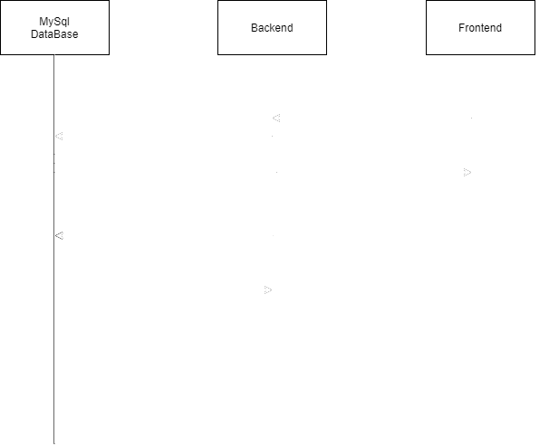
APPROACH AND SOLUTION

Slide 5
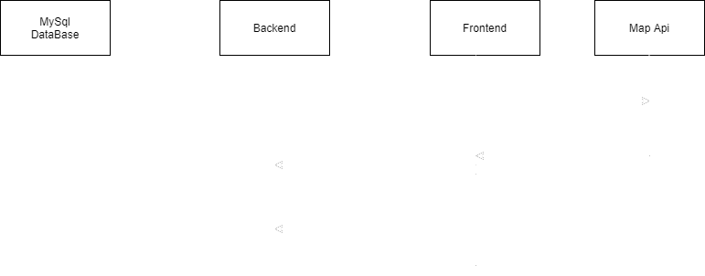
Sequence Diagram of Map My India API

Slide 6
IMPLEMENTATION OF SPRING BOOT REST API
Create the Models, Repositories, Controllers and Exceptions:
Create the User, Address and File Models. In Models need to declare the necessary fields and specifications.
Create the Repositories has interfaces like User Repository and Address Repository extend Spring Data JPA (JpaRepository) to interact with Database.
Create the Auth controller using end points for HTTP methods and operations like POST,GET,PUT,DELETE).
Auth Controller handle signup/login /upload/files requests & authorized requests.
5. Creating the necessary exceptions
Notes:
1. Create the Models

Slide 7
IMPLEMENTATION OF SPRING BOOT REST API
In Spring Application
1.Creating Web Security Configuration
2.Creating User Details service
3.Creating User Details Service Implementation
4.Creating Username Password Authentication Token
5.Creating Authentication Manager
6.Creating Once Per Request Filter
7.Creating Payload
8.Creating Authentication Entry Point
9.Creating File Storage Service
Notes:
Create Spring Security

Slide 8
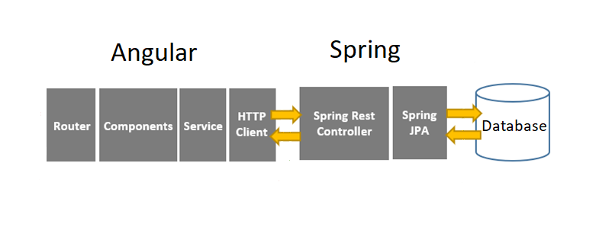
APPROACH AND SOLUTION
Above diagram represent the view of communication between Angular, Spring Boot, Database.
Notes:
Above diagram represent the view of communication between Angular, Spring Boot, Database.
Using Rest API to communicate between Frontend(Angular) and Backend(Spring Boot).

Slide 9
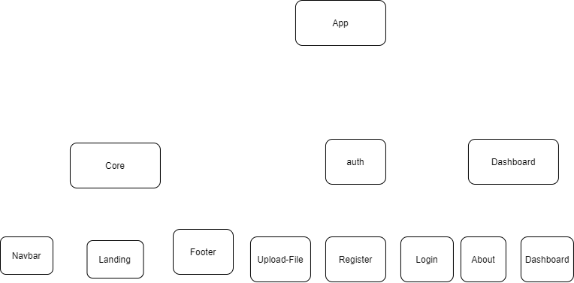
ANGULAR
Notes:
Angular:

Slide 10
CHALLENGES
The Main challenge we faced was using the Map My India API and performing the operations
Creating a JSON Web Token and authenticating it is a very new task

Slide 11
TAKEAWAY
Developing an End-to-End Web Application Which include Rest-API Calls, JWT Token Creation, Authentication
Dealing with a third-party API and handling the search or add requests

Slide 12
Think Different Way
We Can Implement Front End Using React Redux and backend instead of spring there are various frameworks like Express etc.,
We can create more features like after validating a particular address the map should appear on the dashboard pointing to the location

Slide 13


